Slide 1
Software Testing
Presented by
J Dhana Laxmi (206E1A0512) & T Pavani (206E1A0532)
Department of Computer Science Engineering,
Gonna Institute of Information Technology & Science,
Aganampudi,
Visakhapatnam

Slide 2
ABSTRACT
Software testing is the process of evaluating and verifying that a software product or application does what it is supposed to do. The benefits of testing include preventing bugs, reducing development costs and improving performance.
This report contains observations and recommendations based upon the internship. This report also includes positin statements submitted to the internship and presentation slides. Presentation addressed software testing standards; best practices in testing; manual verification and automation verification.
Keywords:- Katalon, selenium, Software testing, manual testing, automation testing.

Slide 3
TESTING
Software testing is a process to find out the bugs and errors from the applications.
Dynamic Testing methodologies are of 2 types:
i) Specification based / Functional / Black box testing
ii) Structured based / Non-functional/ White box testing

Slide 4
Types of testing
There are two types of testing
1. Manual testing
2. Automation Testing

Slide 5
MANUAL TESTING
Manual Testing BLUESTONE
BlueStone is India's leading destination for high quality fine jewellery with strikingly exquisite designs. We aim at revolutionizing the fine jewellery and lifestyle segment in India with a firm focus on craftsmanship, quality and customer experience. In a short span of time, BlueStone has built a large family of loyal consumers in India and abroad.
BlueStone is a web-based e commerce application and it deals with all type of jewellery items and it has both mobile app support for customers to track orders and easy access .

Slide 6
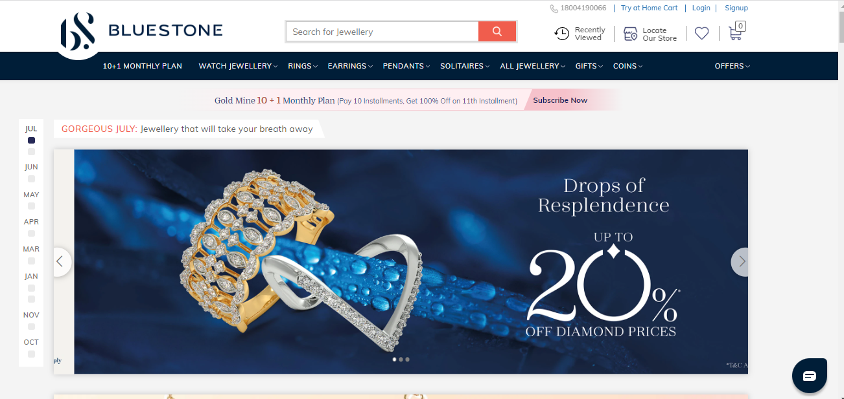
BLUESTONE HOME PAGE:

Slide 7
Project Flow:
User can search the desired product from global search
User can register once and continue shopping and track items while delivery
User can get updates on need basis
User can also continue shopping using mobile app

Slide 8

Product Module:
Gold Mine Text Verification In Terms Of Color ,Font ,Spacing Between Words, Design And Alignment

Slide 9
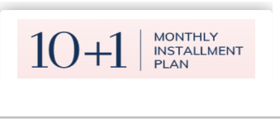
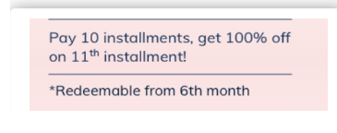
10+1 , MONTHLY INSTALLMANET PLAN Text Verification In Terms Of Color ,Font ,Spacing Between Words, Design And Alignment
Verifying Other Text In Terms Of Color, Font, Spacing Between Words, Design And Alignment

Slide 10
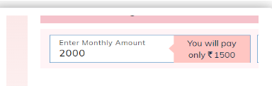
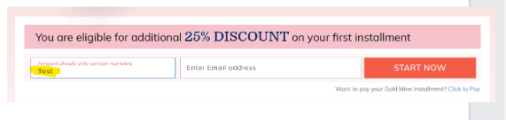
Verifying Monthly Amount In Terms Of Color ,Font ,Spacing Between Words, Design And Alignment
Verify user able to enter amount in field and application should accept the user to enter amount
Verify user able to enter some text in amount in field and verify application accepting the user to enter data

Slide 11
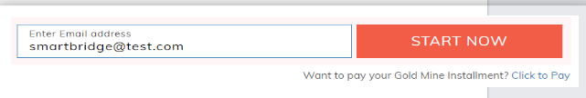
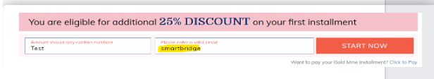
. Verifying Email Address And START NOW Button Color And Functionality And Below Text In Terms Of Color ,Font ,Spacing Between Words, Design And User Able To Enter Email And Verify The Functionality Of It.
Verifying enter email address field validation when user enter invalid email

Slide 12
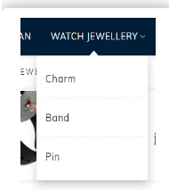
WATCH JEWELLERY
Under Watch Jewellery for various watches with charm model , Band model, Watch PIN model

Slide 13
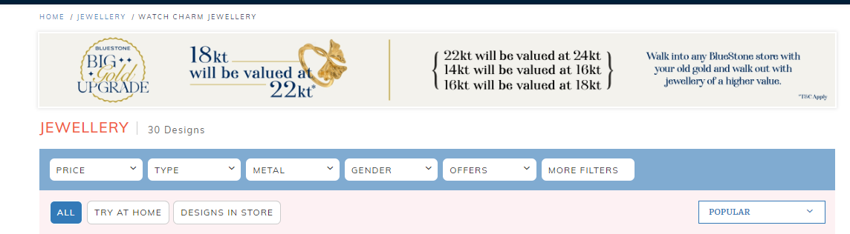
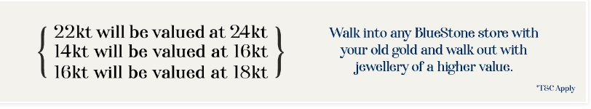
Verifying Charm Model In Terms Of Color ,Font ,Spacing Between Words, Design And Whole Representation
Verifying all the text available on screen in terms of color ,font ,spacing between words, design

Slide 14
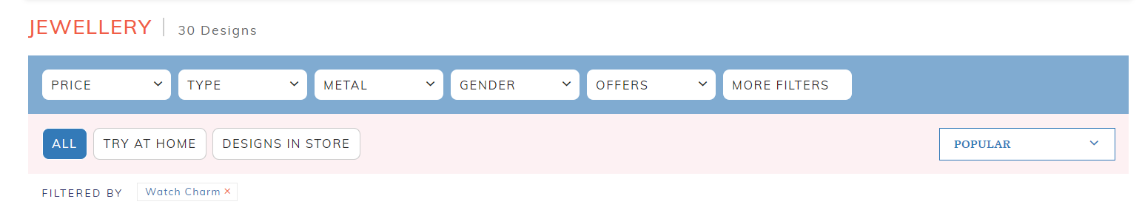
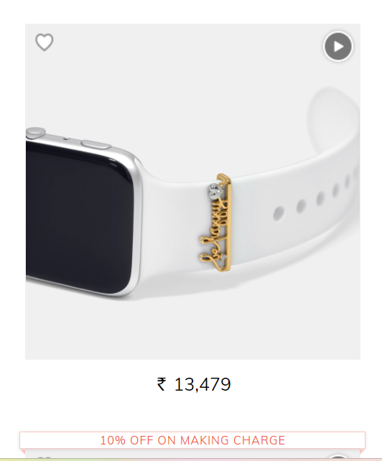
Verifying various filter types once we apply on filter how the application is filtering out results and how the results are loading.
Verifying various images are loading properly and videos are playing when user trying to play it or not related to items. Verifying the different price for different Items.

Slide 15
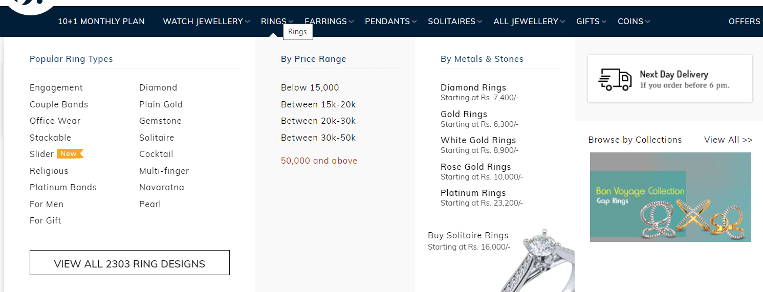
Verifying RINGS Module And It’s Sub Modules

Slide 16
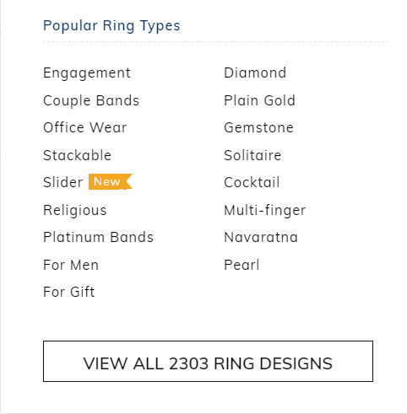
Verifying Rings Sub Modules Like Popular Ring Types And All Links Are Redirecting To Pages Or Not And All Links Are Clickable And Having Any Tags Beside To Existing Types
Verifying Link Functionalities For Each Individual Sub Modules
Verifying each and every sub module links functionality, upon clicking each link is it navigating to desired pages are not

Slide 17
Verifying links are navigating to desired page
In simple words, when user clicks on sub module links it has to navigate to desired link and show the products accordingly
Verifying user able to load more results by clicking on ‘VIEW ALL <<NUMBER>> RING DESIGNS
When User clicks on ‘VIEW ALL <<NUMBER>> RING DESIGNS , it has to load all rings designs available and show images of rings with rates of that particular ring

Slide 18
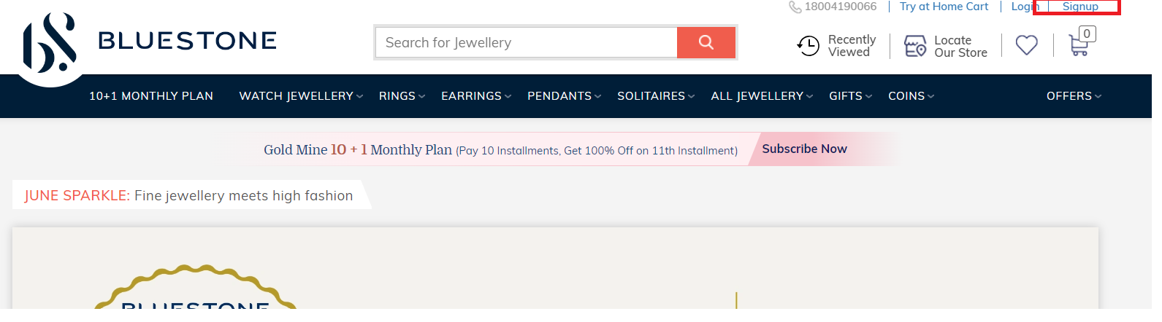
Verifying Signup Link Functionality
. Verifying User Is Able To Click On Signup Link And Able To See Link On Top Right Corner
Verify user is able to see color ,font, and words alignment of ‘Signup’ text

Slide 19
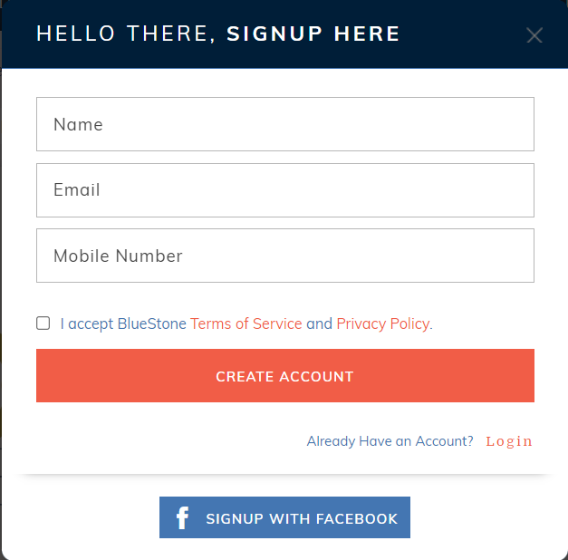
Verifying User Able To Enter All Required Information In The Signup Form And Able To Complete Signup Process With All Positive And Negative Data
Verifying user able to Signup with facebook account if user is having a facebook account

Slide 20
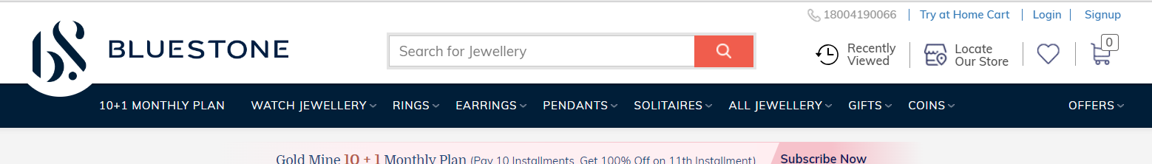
Verifying Login Link Functionality
Verifying User Is Able To Click On Login Link And Able To See Link On Top Right Corner
Verify user is able to see color ,font, and words alignment of ‘Login text

Slide 21
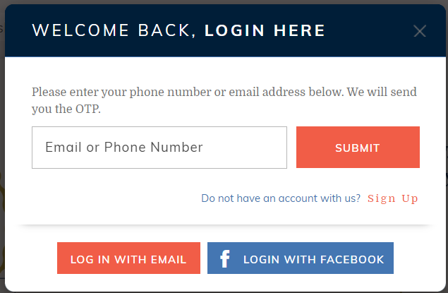
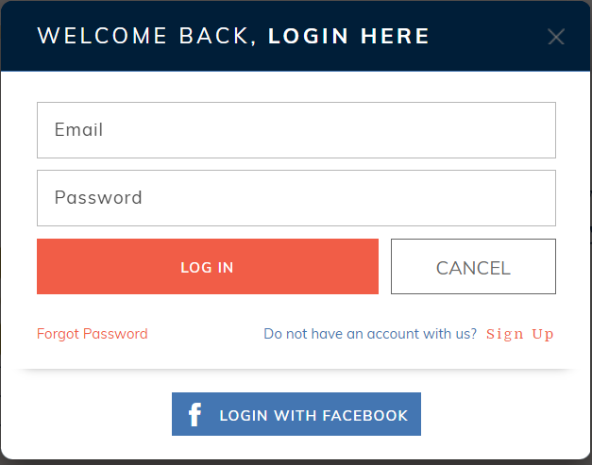
Verifying User Able To Enter All Required Information In The Login Form And Able To Login Successfully With All Positive And Negative Data
Verifying user able to login with email account in the Login form and able to login successfully with all positive and negative data

Slide 22
Final Testing Areas:
Test the Home page elements color, font, alignment, design
Test the global search
Test the Try Home Cart , Login, Signup link functionality
Test the recently viewed ,Locate store, favourites, Cart functionality
Test each and every module and sub module functionality is it navigating to desired page
Test videos related to jewellery items playing correctly or not
Test price for each item
Test filters to load results is correctly working or not
Test all dropdowns are correctly loading the results
Test loading results from dropdown are accurate or not
Test browser compatibility
Test user is able to navigate to Top section when user at bottom by clicking on TOP button
Test user is able to chat with executive

Slide 23
Automation Testing
Project Overview
The BLUESTONE project aims to automate various tasks on the Bluestone website. It leverages Selenium, a powerful web automation tool, to interact with web elements and perform actions such as clicking buttons, filling forms, and extracting data.

Slide 24
Getting Started
Prerequisites
Before getting started with the BLUESTONE project, ensure you have the following prerequisites:
List the software and tools that need to be installed before running the project, such as
Python (3.x)
Selenium (3.x)
Pytest (Latest Version)
Any other dependencies
Installation
To install the necessary dependencies for the BLUESTONE automation project, follow these steps:
Install Python: Visit the Python website (https://www.python.org) and download the latest version of Python. Follow the installation instructions for your operating system.

Slide 25
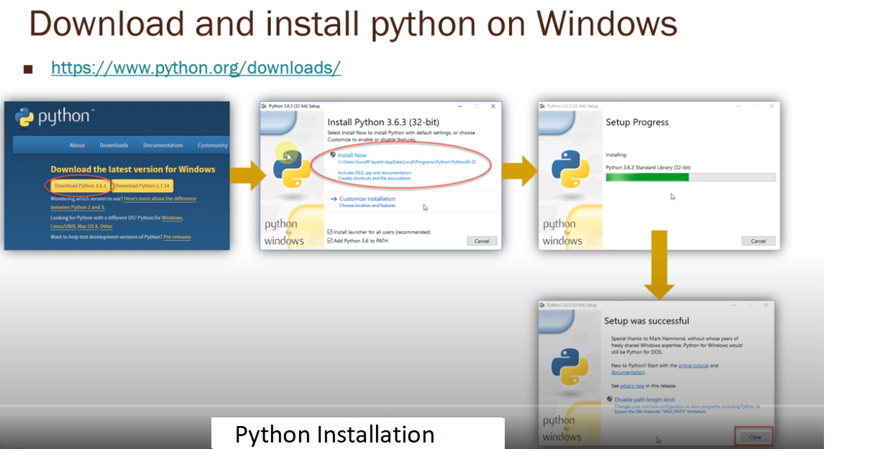

Slide 26
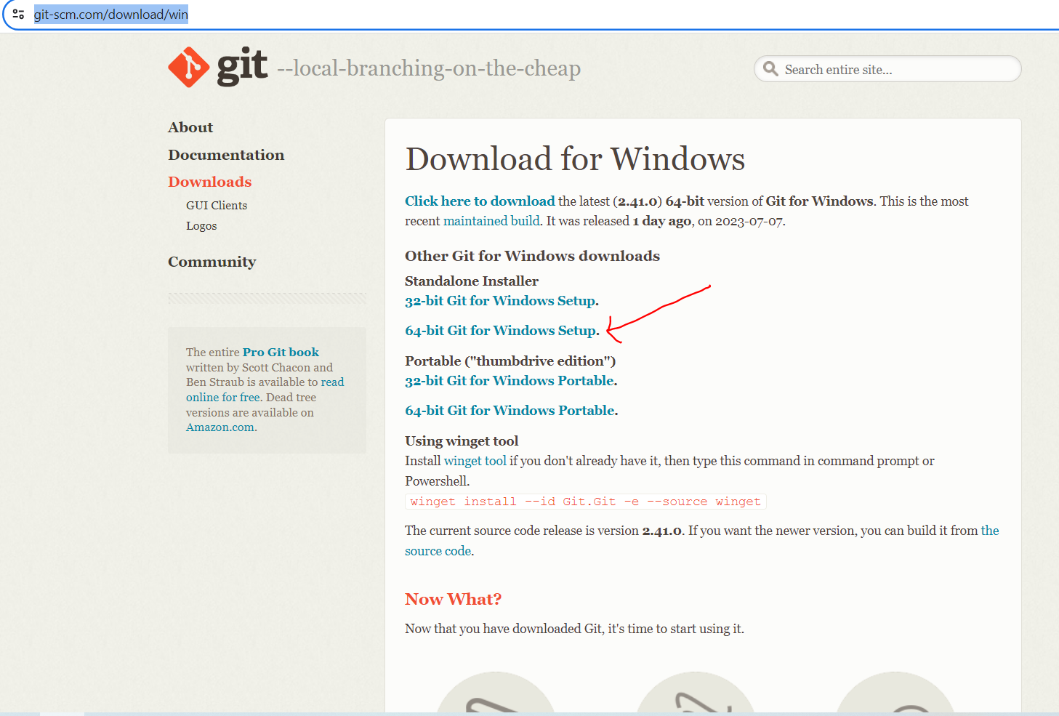
Download and install gitbash from https://git-scm.com/download/win

Slide 27
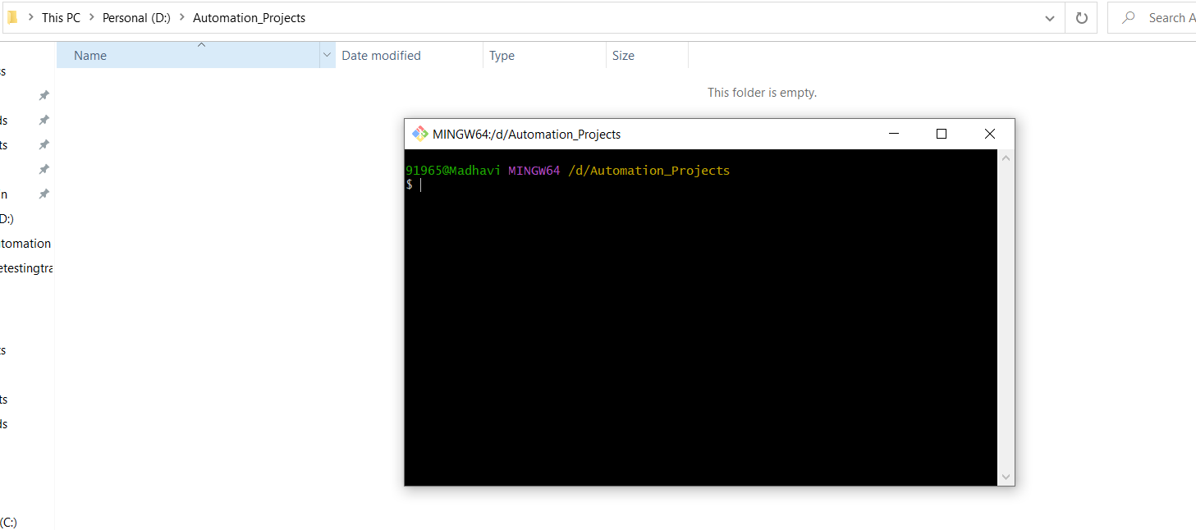
Go to the desired location where you want to create the folder, such as Desktop.
Folder name like eg…(Automation_Testing_Project)
Open the folder-???? Right click with in the folder and select open gitbash here, you will get pop up like below and clone the repository based on the next steps provided below.

Slide 28
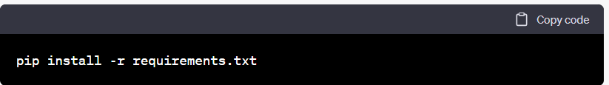
Project Setup
Explained how to set up the project locally, including steps like:
Activity 3.1:- Clone the repository from github.
Activity 3.2:- Clone the BLUESTONE project repository from [repository URL].
https://github.com/viswatesting123/SmartBridge_Automation_Projects.git
Activity 3.3:- Install all dependencies using requirements.txt
Requirements.txt containing all software’s/libraries required for our projects. We don’t need to install separately.
Activity 3.4:- RUN the command from the terminal:

Slide 29
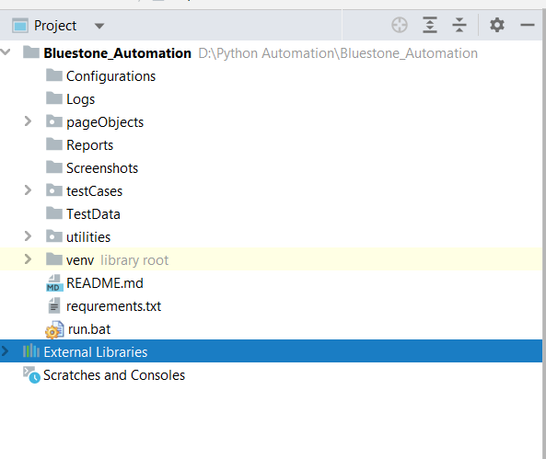
Project Structure
Explained The Structure Of The Project, Including Directories And Files, And Their Purposes. For Example:
testcases/: Directory containing test scripts
pageObjects/: Directory containing page object models
utils/: Directory containing utility functions
reports/: Directory containing test reports
testData/: Directory containing test data related to project
Configuration/: Configuration file for storing settings
Screenshots/: Project testcases screenshots.
Logs/: Directory maintain the project logs.
Run.bat/: Now, you can double-click the run.bat file to execute the Python script specified in the command. The script will run in a Command Prompt window.

Slide 30
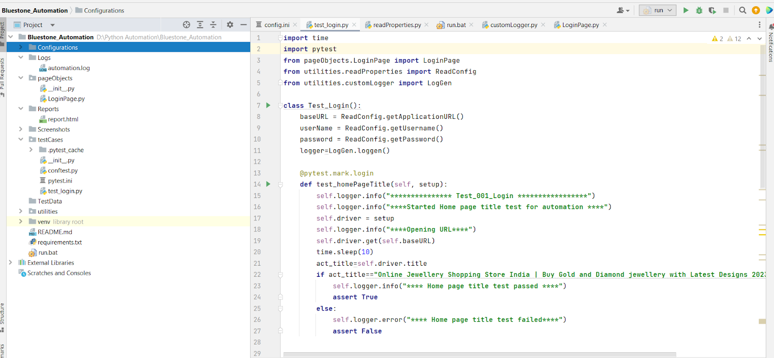
Writing Test Cases
Explained how to write test cases using Python, Selenium, and pytest. Provide examples of different types of test cases, such as:
Test case 1: Home Page functionality
Test case 2: Register
new user functionality
Add new testcases as
per Manual testcases prepared.
Include best practices for
writing maintainable and readable
test cases.

Slide 31
Running Tests
Explained how to run the test cases using pytest. Include information about command-line options and flags that can be used to customize test execution.
Run.Bat/:
Now, you can double-click the run.bat file to execute the Python script specified in the command. The script will run in a Command Prompt window.

Slide 32
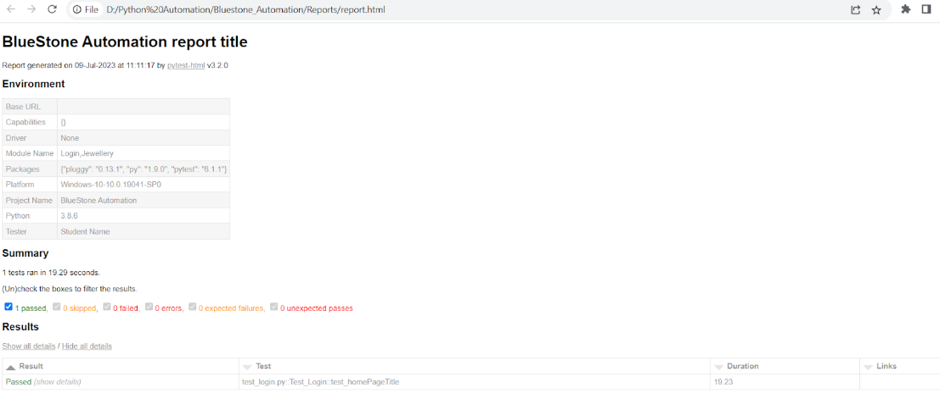
Test Reporting
Explained how test reports are generated and where they are stored. Include information about any tools or libraries used for reporting, such as pytest-html.
Reports/:
Directory containing test reports

Slide 33
Troubleshooting
List common issues that may occur during project setup or test execution and provide possible solutions.

Slide 34
Conclusion
The BLUESTONE automation project provides a framework for automating various tasks within the BLUESTONE web application using Python, Selenium, and Pytest. With this documentation, you should be able to set up the project, execute tests, and extend/customize it according to your needs.

